Slide 1
Virtual Memory
Paging

Slide 2
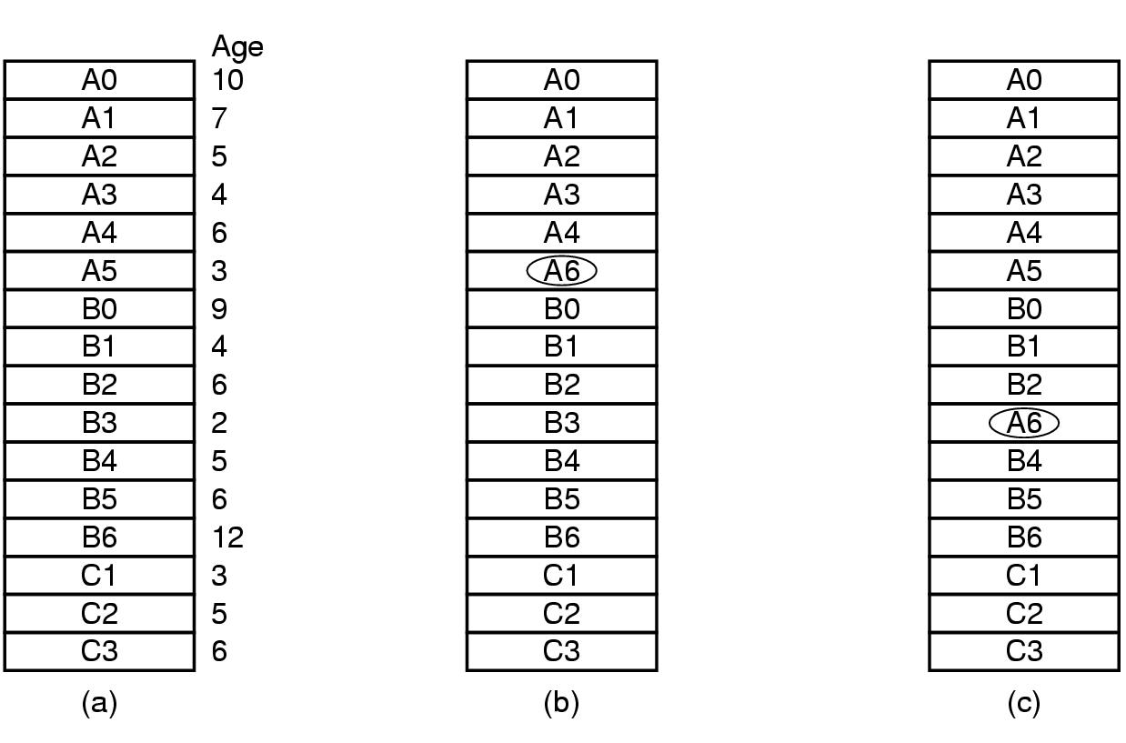
Virtual Memory
Design issues: Local versus Global Allocation Policies
(a) Original configuration
(b) Local page replacement
(c) Global page replacement
1

Slide 3
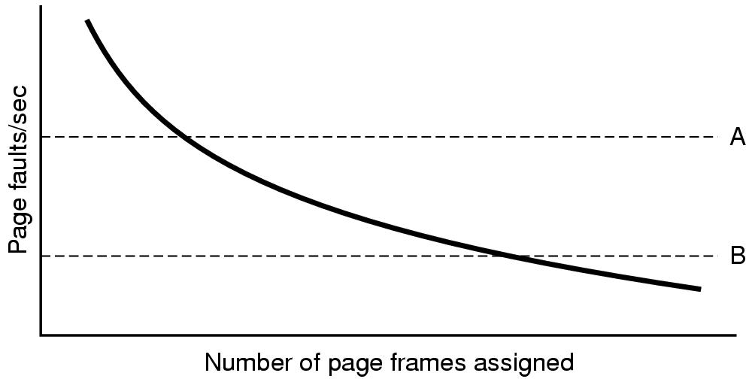
Virtual Memory
Design issues: Page Frame Allocation
Page fault rate as a function of the number of page frames assigned

Slide 4
Virtual Memory
Design issues: Page Size (1)
Small page size
Advantages
  less internal fragmentation
  better fit for various data structures, code sections
  less unused program in memory
Disadvantages
  programs need many pages, larger page tables

Slide 5
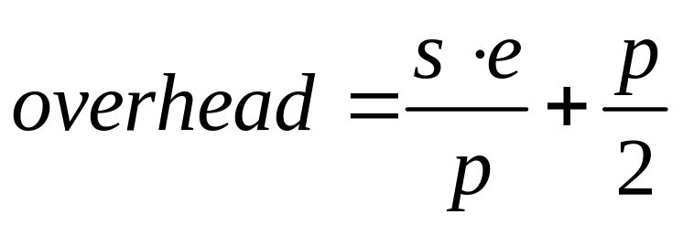
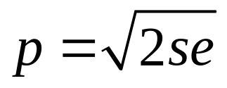
Virtual Memory
Design issues: Page Size (2)
Overhead due to page table and internal fragmentation
Where
  s = average process size in bytes
  p = page size in bytes
  e = page entry in bytes
page table space
internal fragmentation
Optimized when

Slide 6
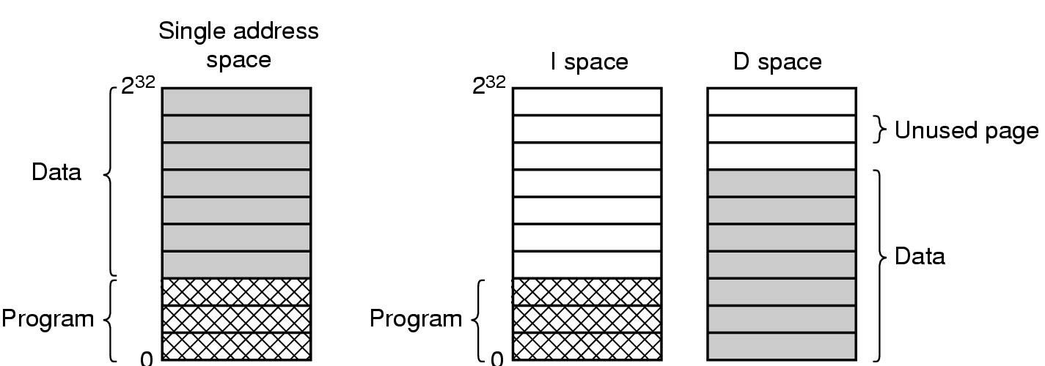
Virtual Memory
Design issues: Separate Instruction and Data Spaces
One address space
Separate I and D spaces

Slide 7
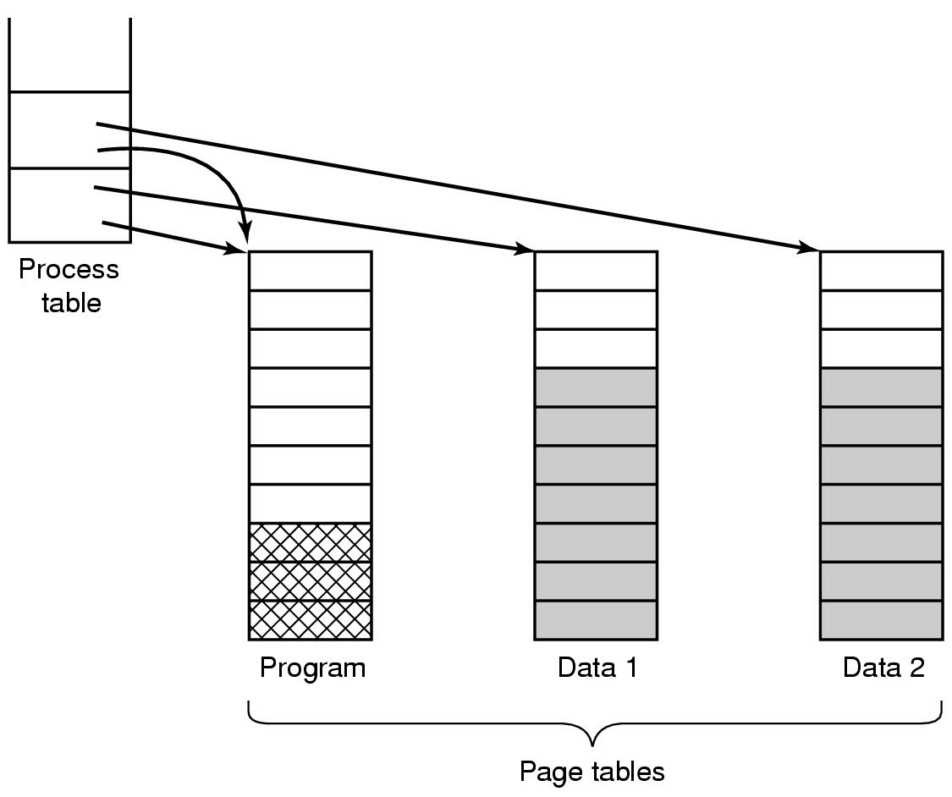
Virtual Memory
Design issues: Shared Pages
Two processes sharing same program sharing its page table

Slide 8
Virtual Memory
Design issues: Cleaning Policy
Need for a background process, paging daemon
  periodically inspects state of memory
When too few frames are free
  selects pages to evict using a replacement algorithm
It can use same circular list (clock)
  as regular page replacement algorithm but with diff ptr

Slide 9
Virtual Memory
Implementation Issues
Operating System Involvement with Paging
Four times when OS involved with paging
Process creation
  determine program size
  create page table
Process execution
  MMU reset for new process
  TLB flushed
Page fault time
  determine virtual address causing fault
  swap target page out, needed page in
Process termination time
  release page table, pages

Slide 10
Virtual Memory
Implementation Issues
Page Fault Handling (1)
Hardware traps to kernel
General registers saved
OS determines which virtual page needed
OS checks validity of address, seeks page frame
If selected frame is dirty, write it to disk

Slide 11
Virtual Memory
Implementation Issues
Page Fault Handling (2)
6. OS brings schedules new page in from disk
7. Page tables updated
8. Faulting instruction backed up to when it began
9. Faulting process scheduled
10. Registers restored, Program continues

Slide 12
Virtual Memory
Implementation Issues
Locking Pages in Memory
Virtual memory and I/O occasionally interact
Proc issues call for read from device into buffer
  while waiting for I/O, another processes starts up
  has a page fault
  buffer for the first proc may be chosen to be paged out
Need to specify some pages locked
  exempted from being target pages

Slide 13
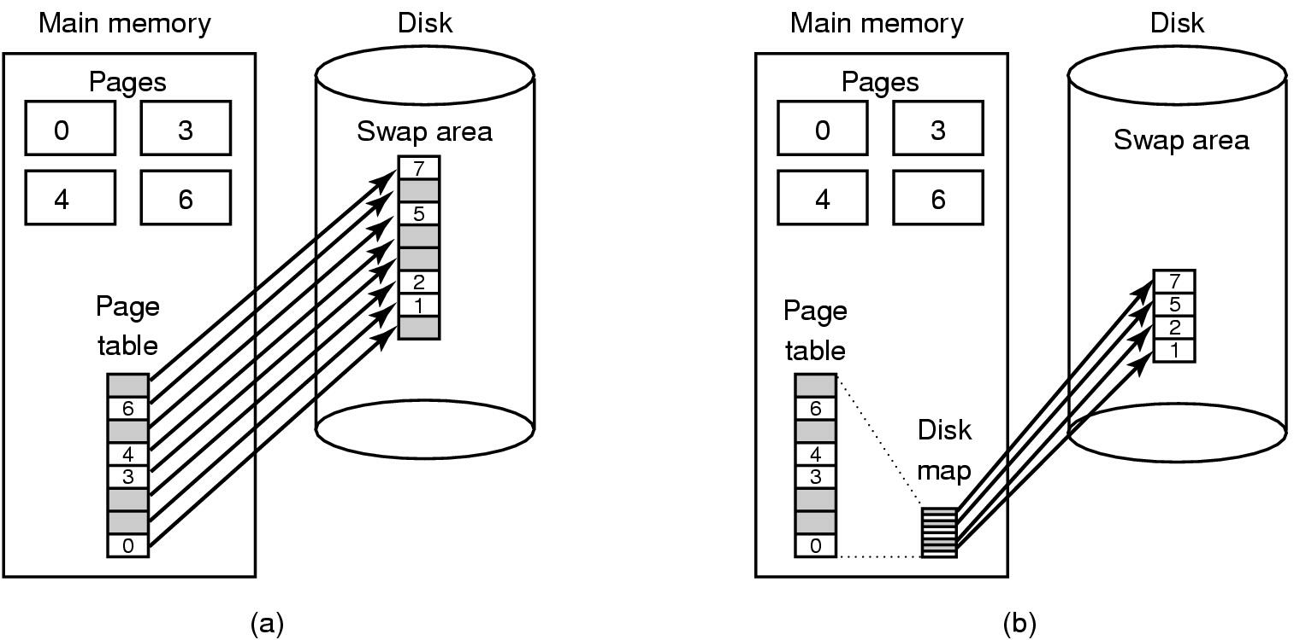
Virtual Memory
Implementation Issues: Backing Store
(a) Paging to static swap area
(b) Backing up pages dynamically

Slide 14
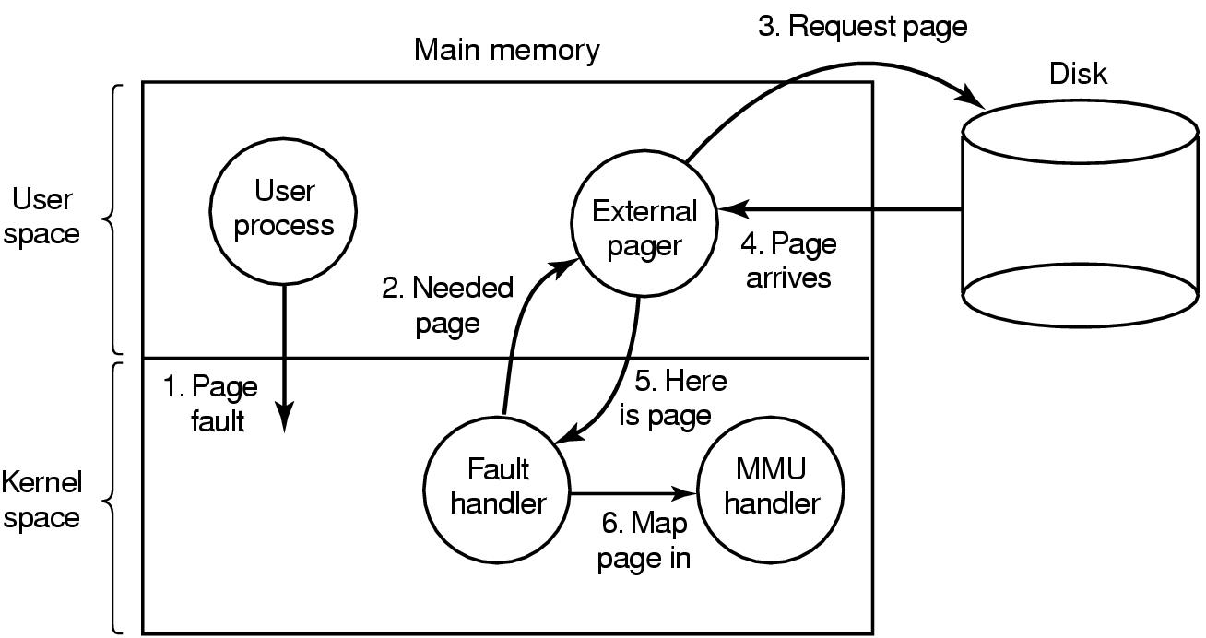
Virtual Memory
Implementation Issues
Separation of Policy and Mechanism
Page fault handling with an external pager

